Slide 1
Decision Trees

Slide 2
Graphviz package installed on python

Slide 3
Lecture Resources
I'm relying heavily on this one: https://machinelearningmastery.com/what-is-information-entropy/
https://victorzhou.com/blog/information-gain/
https://www.tutorialspoint.com/difference-between-entropy-and-information-gain
https://pro.arcgis.com/en/pro-app/latest/tool-reference/geoai/how-decision-tree-classification-and-regression-works.htm
https://kindsonthegenius.com/blog/how-to-build-a-decision-tree-for-classification-step-by-step-procedure-using-entropy-and-gain/

Slide 4
Information Theory
We are going to need to learn some concepts in this first before we talk about decision trees
Probability is going to underlie these concepts, as before with Bayes
Information Theory is a lot about quantifying uncertainty – looking at how 'surprising' or 'unsurprising' an event is
Developed by Claude Shannon at Bell Labs

Slide 5
Let's look at some levels of surprise
Tomorrow, the sun will rise
Tomorrow, it will be cloudy
Tomorrow, you will be attacked by wolverines

Slide 6
Let's look at some levels of surprise
Tomorrow, the sun will rise
Not surprising. Basically guaranteed to happen.
Tomorrow, it will be cloudy
Maybe surprising, maybe not – depends on the time of year
Tomorrow, you will be attacked by wolverines
Very surprising

Slide 7
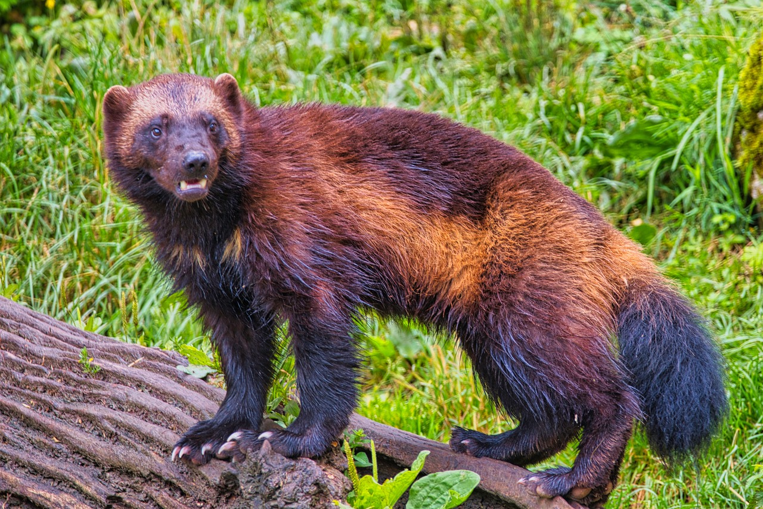
Let's look at some levels of surprise
Tomorrow, the sun will rise
Not surprising. Basically guaranteed to happen. (Low information)
Tomorrow, it will be cloudy
Maybe surprising, maybe not (Medium information)
Tomorrow, you will be attacked by wolverines
Very surprising (High information. You'll probably make the paper.)

Slide 8
Calculating the Information of an Event
We can calculate the information of an event:
Information of event x = -log(p(x))
Using log base 2
We can see there is an inverse relationship between information of an event and probability
Sun will rise tomorrow: 100% probability, 0 information
Tomorrow will be cloudy, 50% probability, 0.301 information
You will be attacked by wolverines (let's say 1 in 1 million): 6 information
Information often written as h(x)
Information always >= 0
Source: https://machinelearningmastery.com/what-is-information-entropy/

Slide 9
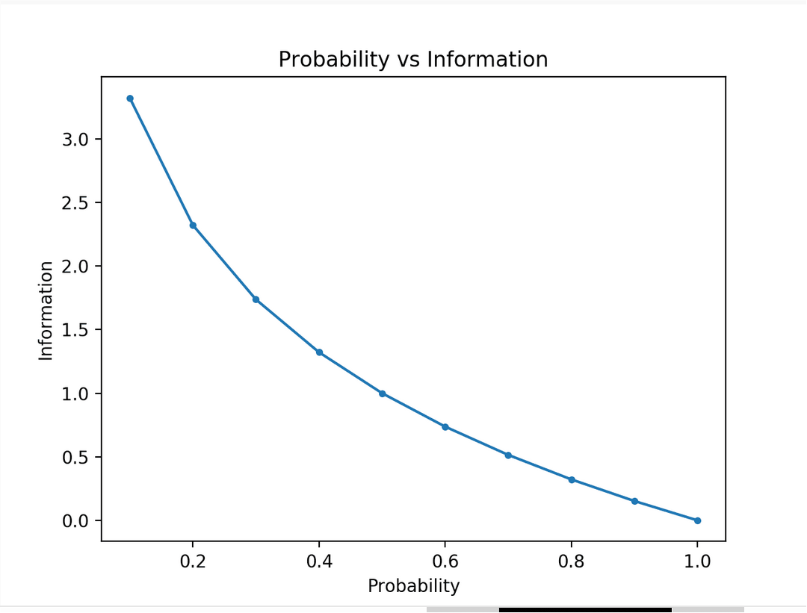
Source: https://machinelearningmastery.com/what-is-information-entropy/

Slide 10
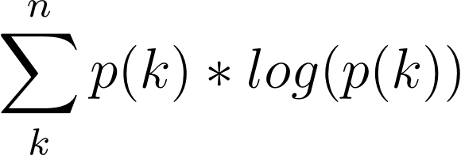
Entropy
Sometimes also called Shannon Entropy, fyi
How much information is in a random variable – basically looks at the variance of the random variable
Random variable x
K states in x
N instances of random variable x
Entropy of x =
Source: https://machinelearningmastery.com/what-is-information-entropy/

Slide 11
Entropy
Entropy gives you basically a measure of the average information in your distribution of the variable
Low entropy for average unsurprising distributions
High entropy for average surprising distributions
A balanced dataset has higher entropy than a very skewed one
Source: https://machinelearningmastery.com/what-is-information-entropy/

Slide 12
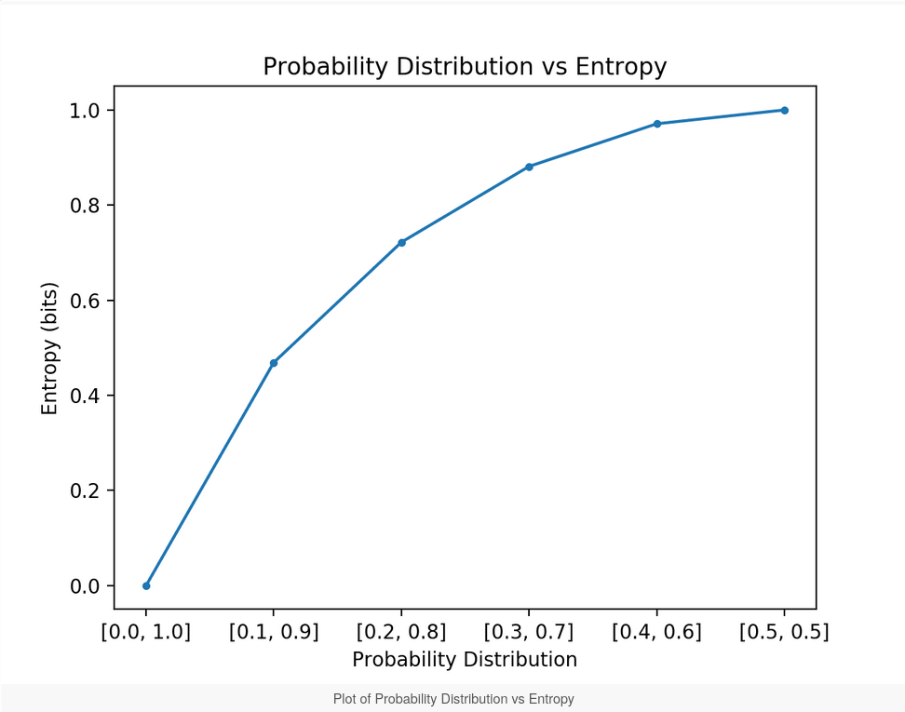
Source: https://machinelearningmastery.com/what-is-information-entropy/

Slide 13
Entropy
Information gain = Entropy removed
That will come in handy for making decision trees
https://victorzhou.com/blog/information-gain/

Slide 14
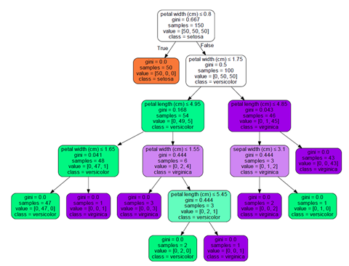
Decision Trees
https://pro.arcgis.com/en/pro-app/latest/tool-reference/geoai/how-decision-tree-classification-and-regression-works.htm

Slide 15
Decision Trees
Decision Trees are basically like flow charts
They have nodes and leaves
You follow the root of the tree down to the nodes and leaves, taking paths based on a value of a feature

Slide 16
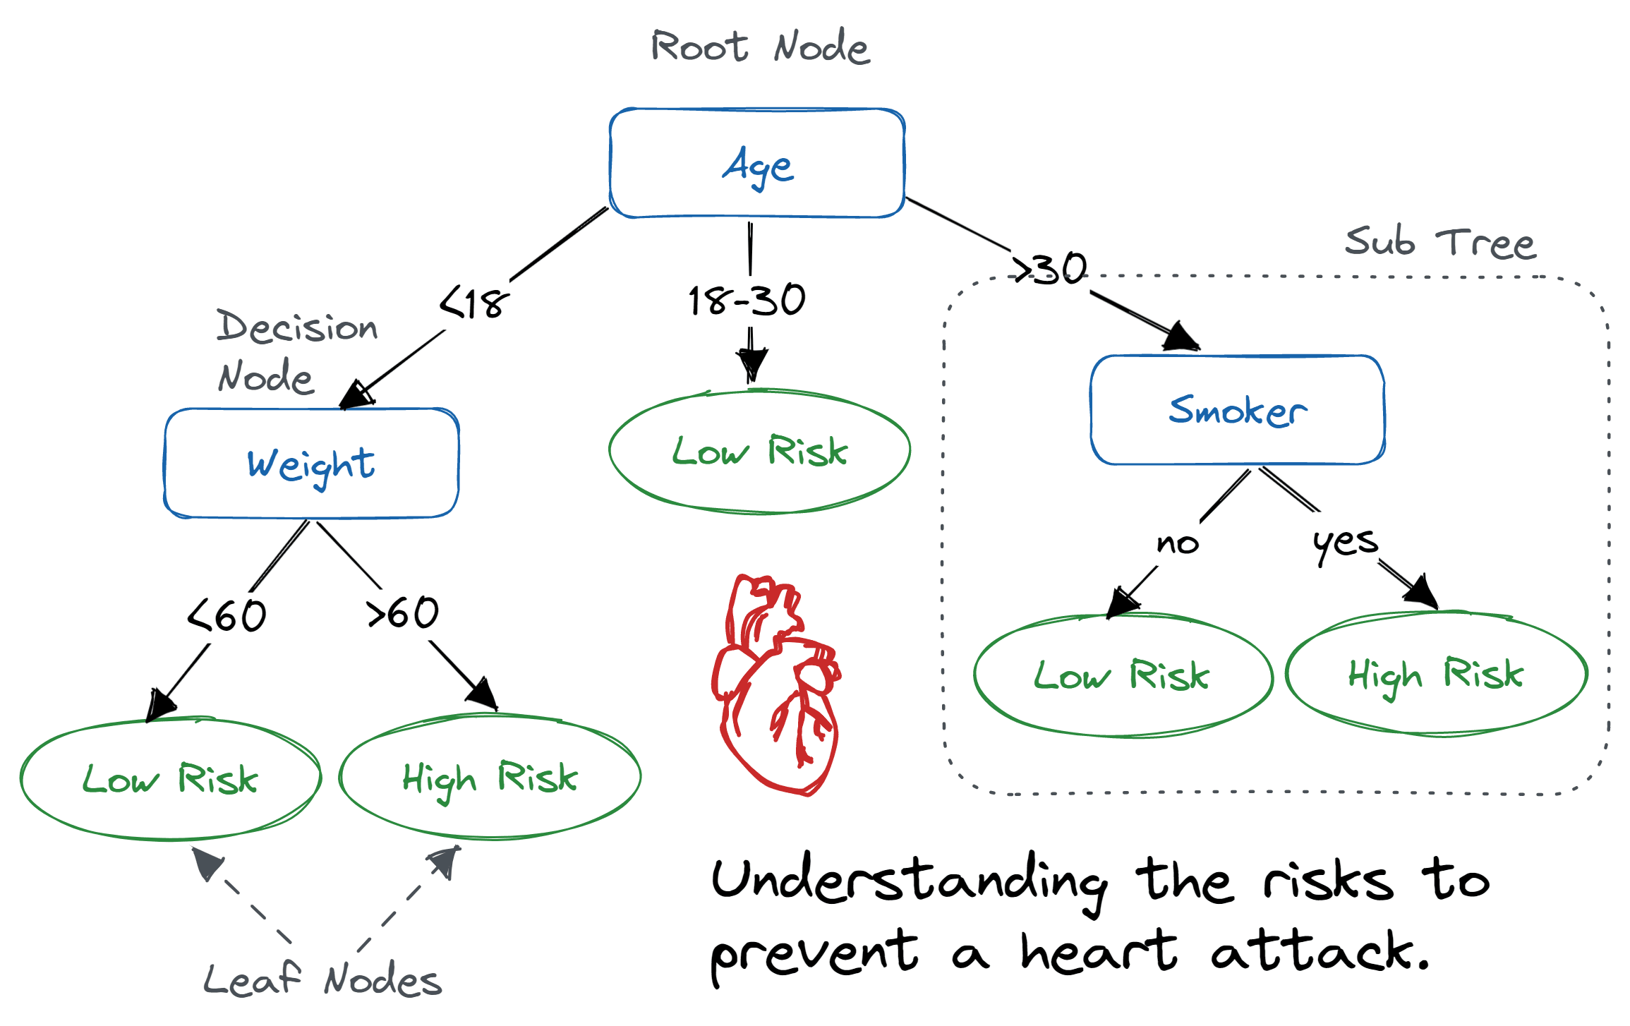
Example
https://www.datacamp.com/tutorial/decision-tree-classification-python

Slide 17
How do we create the trees?
We look for the best splits of the data to have efficient, useful trees
Basically all ways to split the data involve some aspect of information theory – like information gain or the gini index
Let's go through the example from here: https://kindsonthegenius.com/blog/how-to-build-a-decision-tree-for-classification-step-by-step-procedure-using-entropy-and-gain/

Slide 18
Decision Trees
Keep splitting the tree based on values down through the nodes until you have split the categories or run out of nodes
For values that are continuous, arrange the values and generally find averages/midpoints to calculate around

Slide 19
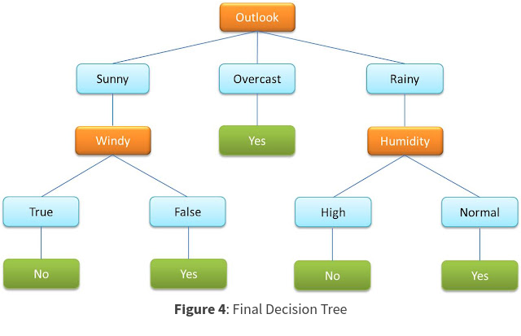
https://kindsonthegenius.com/blog/how-to-build-a-decision-tree-for-classification-step-by-step-procedure-using-entropy-and-gain/

Slide 20
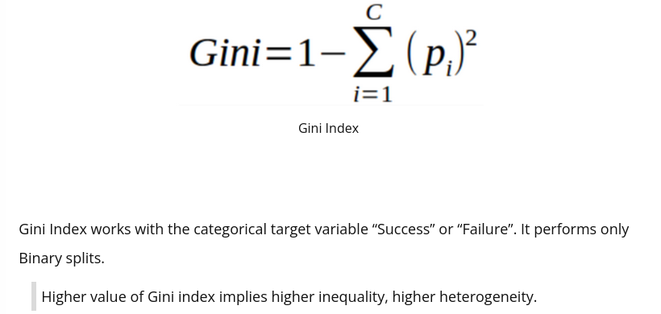
Gini Index
Can use instead of information gain
https://www.kdnuggets.com/2020/01/decision-tree-algorithm-explained.html

Slide 21
Decision Tree Advantages
Very easy to understand = explainable
Look at the lovely flowchart!
Can be very accurate
Intuitive

Slide 22
Decision Tree Disadvantages
Can overfit like mad
Not always great for very high dimensional data

Slide 23
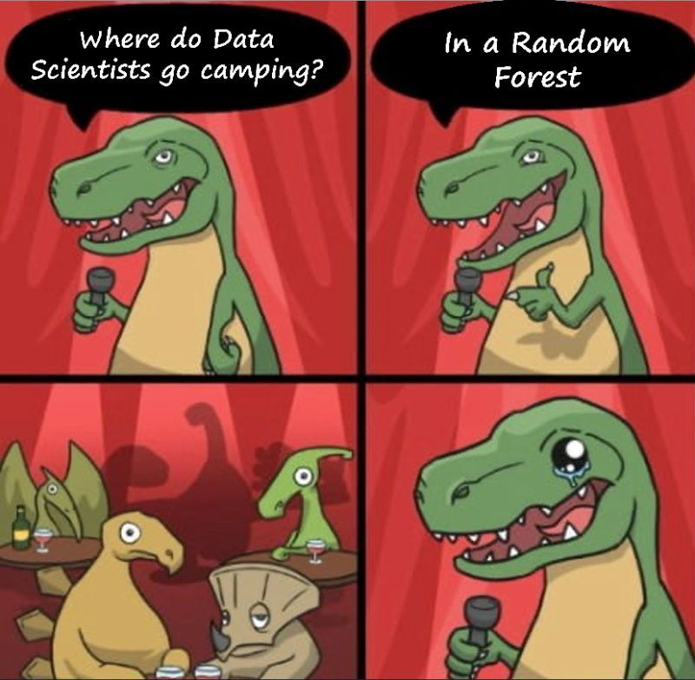
Improvements on Decision Tree
Pruning
Random Forest
https://www.linkedin.com/posts/watitap_this-is-hilarious-what-is-a-random-forest-activity-7060857693221097472-SETf

Slide 24
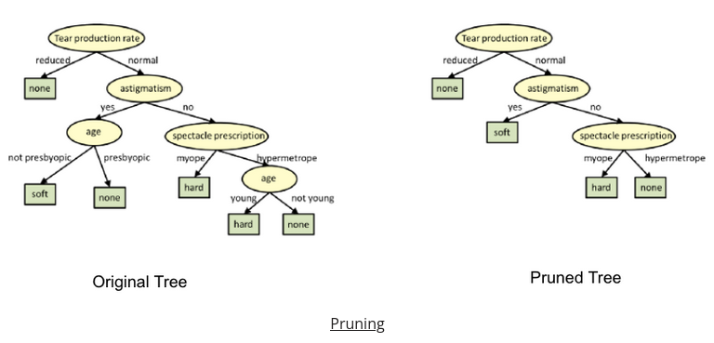
Pruning
Use your validation set to remove branches of the tree without killing accuracy
https://www.kdnuggets.com/2020/01/decision-tree-algorithm-explained.html

Slide 25
Random Forests
Train a BUNCH of decision trees
Often only on a subset of the data
Average the answers together or use some weighting/voting system
This is an ensemble method
Can be very powerful!
Slightly less explainable than a typical decision tree
https://scikit-learn.org/stable/modules/generated/sklearn.ensemble.RandomForestClassifier.html

Slide 26
Let's Code!
Steel Dataset -> prediction of defects

Slide 27
Back to Basics!
Dataset
Type of Machine Learning
Data Split
Model Evaluation

Slide 28
When might you use a Decision Tree?
When you need a highly explainable model
When you have a small-ish dataset
When the dataset is highly related to management decisions or other analysis
When you have tabular data

Slide 29
When might you use a Random Forest?
When accuracy is an important tradeoff compared to explainability

Slide 30
Questions?

